Slide 1
Git Branching Models and Workflows
Kevin Scannell, David Ferry
CSCI 5030 – Principles of Software Development
Saint Louis University
St. Louis, MO 63103

Slide 2
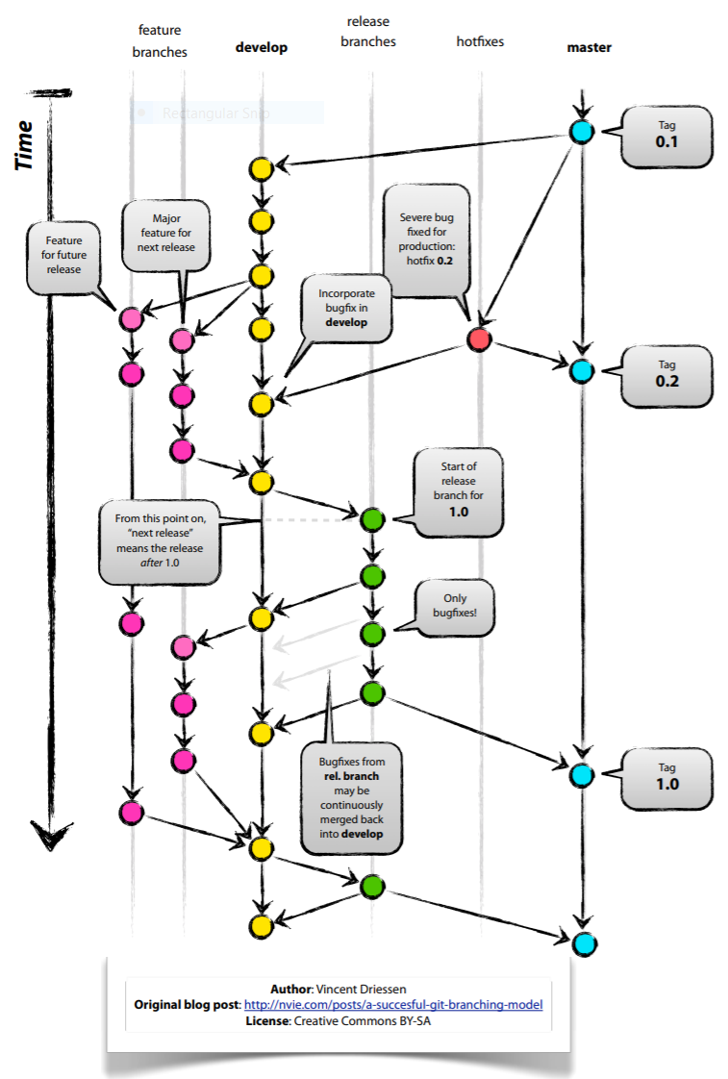
“A Successful Git
Branching Model”

Slide 3
“A Successful Git Branching Model”
Git allows frictionless branching and merging
  Notes branching is an advanced topics in centralized/SVN books
Branches that live forever: master and develop
  master is stable, always production ready, pushes to master are releases by definition
  develop is used to integrate completed features (where nightly builds might happen)
Other branches: features, releases, hotfixes
No other branches allowed
  We never branch off of a feature branch, etc.

Slide 4
“A Successful Git Branching Model”
Feature branches
  Branch off develop and merge back to develop (or discarded)
  Almost all changes, including trivial ones, or long-lived feature development
Release branches
  Branch off develop and merge to both develop and master.
  Created in leadup to release, no new features added once branched, just bug fixes
Hotfix branches
  Branch off master and merge back to master and develop
  Quick fixes of critical bugs in master branch

Slide 5
Why is Git Branching Different?
Compare to the centralized approach
  Branches are full, but lightweight copies
    Implemented as a pointer to a commit
    Centralized version control might be as heavyweight as full source code copy
  “Workspace-oriented”
    Commits are “snapshots” of the entire project
    Branches are copies of the entire project
    Versus revision histories of specific files
  Feature branches keep prototype code separate from integration-ready code
    Especially key when multiple developers are working simultaneously

Slide 6
“A Successful Git Branching Model”
Devil’s Advocate:
  Long-lived feature branches
    Integration gets harder the longer you’re separate
    Continuous integration should be gold standard
  Shared remote branches
    Two or three developers can go off on their own
    Planned changes should be available on development branch as soon as possible
  Make releases using new branches rather than keeping master branch special
    Semantics?

Slide 7
“Distributed Git
Distributed Workflows”
Centralized Workflow
  All developers push/pull to a single central repository
Integration-Manager Workflow
  “Project maintainer” integrates (merges) contributions in their repository, validates them, and pushes changes to the official repo
  Very common in open source projects
  Common in medium-large teams
  “integration manager” could be peer reviewers
Dictator and Lieutenants Workflow
  Multiple project maintainers for very large projects

Slide 8
Merging 101
Three important commits to every merge:
The common ancestor
Head of branch 1
Head of branch 2
The goal of merging is to combine these
three snapshots of the system.
HEAD
HEAD
feature
master

Slide 9
Simple: The Fast-Forward Merge
If one of the two branches has no commits after the merge, then git can implement the merge just by manipulating the commit tree structure. This has a side effect of making the merge “invisible.” --no-ff forces git to make a merge commit.
HEAD
master
HEAD
HEAD
HEAD
HEAD
feature
master
feature
master
Before Merge
After Merge
With --no-ff

Slide 10
Typical Merge
When both branches have some commits
after their last common ancestor, Git
creates a new commit that reconciles
the differences between them.
Merge commit is ugly, usually a listing
of all commits made on the branch
since the common ancestor
From the point of view of the master
branch, having all the commits in the
feature branch is not helpful. Instead
“adding feature XYZ” would be useful.
Solution: rebasing
  Avoids “merge commit Christmas tree”
  Some teams love it, some hate it
HEAD
feature
HEAD
master

Slide 11
Rebasing
“Re-bases” the commits from one branch
on top of the commits from another branch.
Temporarily rewind master branch
Apply commits from feature branch
to common ancestor
Replay commits from master branch
Rebasing reorganizes the commit tree
so it looks like a branch was instead a
straight-line development path.
HEAD
HEAD
feature
master

Slide 12
Rebasing Pitfall
Caution: Be careful with rebasing
“in public” with shared repositories.
Commits in Git are identified by
a hash of, among other things,
their ancestor. The bright red
commit has the same contents
as the original purple commit,
but it is not the same commit.
If someone else has created work with
the original commit, that node no longer
exists in the rebased timeline.

Slide 13
Squashing Commits
Before
After
Since rebasing can “rewrite history” you can
also use it to modify previous commit logs.
git rebase –i HEAD~3
You can also split comments as well.
This can be used to clean up a confusing
or otherwise unfortunate commit history.
HEAD
HEAD

