Slide 1
Deadlock
David Ferry
CSCI 2510 – Principles of Computing Systems
Saint Louis University
St. Louis, MO 63103

Slide 2
Who I am
An experienced computer systems instructor
PhD from WashU in Real Time Systems and Parallel Concurrency Platforms (with Chris and Kunal)
Teaching-track at Saint Louis University from 2016-present
Subjects:
  Mostly computer systems
  Freshman CS for engineers
  Some theory
  Some software engineering
About 80% undergraduate, 20% graduate
Service as undergrad coordinator, dual-credit supervisor, curriculum committee chair, assessment chair, search chair…
Worked through scaling courses from 20->50 person

Slide 3
Teaching Talk Intro
From course:
CSCI 2510 – Principles of Computer Systems
Broad introduction to software systems engineering as a discipline
Conceptual focus on non-functional software qualities and constraints
  Performance, reliability, scalability, maintainability, safety, security, etc.
Topical focus on concurrent, parallel, and networked programming, with some security as well
Typically a 4th semester course for students
  Prereqs are data structures and our first systems class
  Last required systems course for all students

Slide 4
Note on Teaching Style
Started this class as lecture with studios
  Goal was a 30/20 split on lecture/work time
Trialed flipped classroom before the pandemic
  Worked poorly during pandemic
Current evolution:
  Have full lecture days and in-class work days focused around major lab assignments
  Studios are take home and graded on completion, but designed to scaffold major lab assignments

Slide 5
More Notes on Teaching Style
Student engagement is critical
Try hard to be more meaningful and compelling than laptops and phones
In-class exercises and quizzes are submitted on Canvas
  Focuses attention at key points
  Pseudo-attendance grade

Slide 6
Blocking Operations
Recall- Some operations cause a program to wait.
Quiz: Which of the following operations could cause blocking?
A. Locking a mutex
B. Opening a file
C. Reading a file
D. Reading from a pipe
E. Writing to a pipe
Submit on Canvas

Slide 7
Blocking Operations
Recall- Some operations cause a program to wait.
Quiz: Which of the following operations could cause blocking?
A. Locking a mutex (already locked)
B. Opening a file (disk I/O)
C. Reading a file (disk I/O)
D. Reading from a pipe (pipe is empty)
E. Writing to a pipe (pipe is full)

Slide 8
Deadlock
A specific hazard occurs with blocking operations:
Could an adversary scheduler break our code?
mutex a, b;
Thread 1: Thread 2:
lock(a) lock(b)
lock(b) lock(a)
//Critical section //Critical section
unlock(b) unlock(a)
unlock(a) unlock(b)

Slide 9
Deadlock
A specific hazard occurs with blocking operations:
Could an adversary scheduler break our code?
mutex a, b;
Thread 1: Thread 2:
lock(a) lock(b)
lock(b) lock(a)
//Critical section //Critical section
unlock(b) unlock(a)
unlock(a) unlock(b)
1.
4.
Infinite wait
2.
3.

Slide 10
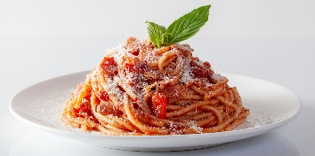
Classic Deadlock Example:
Dining Philosophers
A group of philosophers are sharing a delicious spaghetti meal.
Six thinkers, six forks, each needs two forks to eat.
Each philosopher follows the procedure:
while( 1 ){
1. Ponder mysteries for a while
2. Grab fork to their left (or wait)
3. Grab fork to their right (or wait)
4. Eat
5. Release forks
}
Spaghetti: Powerpoint Stock Photos

Slide 11

Recall – Lab 2
How could deadlock occur if the parent shell process waits on each child after forking instead of just the last?
SLU Shell Process
fork()
fork()
fork()
STDOUT
grep
sort
ls
STDIN
sort output
ls output
pipe
pipe

Slide 12
Recall – Lab 2
How could deadlock occur if the parent shell process waits on each child after forking instead of just the last?
SLU Shell Process
fork()
fork()
fork()
STDOUT
grep
sort
ls
STDIN
sort output
ls output
pipe
pipe

Slide 13
Necessary Conditions for Deadlock
Which of the following elements occurred in all three examples?
Philosophers Locking
Graph cycles Mutex variables
Processes Waiting
Threads Pipes
Resource exclusion Spaghetti

Slide 14
Necessary Conditions for Deadlock
Which of the following elements occurred in all three examples?
Philosophers Locking
Graph cycles Mutex variables
Processes Waiting
Threads Pipes
Resource exclusion Spaghetti
Deadlock is not just a property of threads, locks, and mutexes- it is a general systems problem.

Slide 15
Deadlock Conditions
Resource exclusion – Processes can hold resources in a non-shareable state
Hold-while-waiting – Processes can hold a resource while waiting for another resource
No preemption – Only the process holding a resource can release it
Circular wait – There can exist a set of waiting processes P₁…P_{N} such that P₁ waits on P₂, P₂ waits on P₃, … P_{N-1} waits on P_{N}, and P_{N} waits on P₁
1
6
2
5
3
4
E. G. Coffman. System Deadlocks. ACM Comput. Surv. 3, 2 (June 1971), 67–78.

Slide 16
Deadlock does not require explicit resource acquisition
The shell process calls wait() on the first child process, the child process calls write() on the pipe. The pipe is full. No process ever explicitly acquires a resource.
Possibility of deadlock is an inherent property of a design
That said, most of the time we talk about explicit acquisition
SLU Shell Process
fork()
fork()
fork()
STDOUT
grep
sort
ls
STDIN
sort output
ls output
pipe
pipe

Slide 17
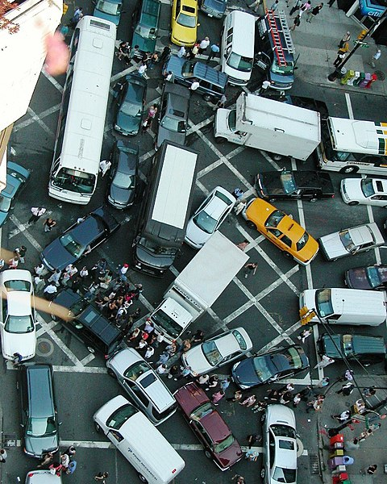
Real-World Example: Gridlock
Is this deadlock?
Resource exclusion
Hold-while-waiting
No preemption
Circular wait
Attribution: Rgoogin at the English Wikipedia

Slide 18
Which of these contain Deadlock?
Rule: Cars must drive in a straight
line until they’re out of their box.
C
E
A
Submit on Canvas
D
B

Slide 19
Can Deadlock is not Will Deadlock
Deadlock may or may not occur during any specific execution
Usually results from a race, so depends on timing
Just like race conditions, thorough testing is not guarantee of finding deadlock
Developer must reason about the system and convince themselves the system is deadlock-free
E.g. Philosophers don’t always deadlock
Exercise: Give an execution for Dining Philosophers that doesn’t deadlock

Slide 20
Starvation
Related concept, will only introduce here:
Starvation – Individual processes may be “unlucky” and unable to progress
Example: Threads race and 1 never gets to lock(a)
mutex a, b
Thread 1: Thread 2: Thread 3:
while (1) { while (1) { while (1) {
lock(a) lock(a) lock(a)
//process data //process data //process data
unlock(a) unlock(a) unlock(a)
} } }

Slide 21
Livelock
Related concept, will only introduce here:
Livelock – Threads aren’t blocked/waiting but also never make progress
Example: Suppose we have “polite threads” that release their first lock if not able to acquire the second lock.
Thread 1: Lock a
Thread 2: Lock b
Thread 1: Try to lock b and fail
Thread 2: Try to lock a and fail
Thread 1: Release a
Thread 2: Release b
Repeat

Slide 22
Deadlock Analysis
Deadlock scenarios are usually analyzed with a directed graph called a resource allocation graph:
Recall: A directed graph G = (V,E) is a set of vertices V and directed edges E, such that an edge a→b does not imply an edge b→a.
Example:
V = {1, 2, 3, 4, 5, 6}
E = {1→2, 2→3, 3→4,
4→5, 5→6, 6→1}
1
6
2
5
3
4

Slide 23
Resource Allocation Graph
The RAG has two sets of vertices-
A set processes/threads drawn as circles
A set of resources drawn as squares
Edge from P to R: P is trying to acquire R
Edge from R to P: P is holding R
P
R
P is waiting for R
R
P
R is held by P

Slide 24
Deadlock Detection
Our first three deadlock conditions reflect semantics of the system which do not change.
  Resource exclusion, hold-and-wait, no preemption
Whether a circular wait exists is a property of the runtime state of a system and does change.
A cycle in the RAG indicates
circular-wait
Edges will alternate between
processes and resources
P
a
b
Q
c
d
R

Slide 25
The Deadly Embrace
A cycle in the RAG indicates deadlock!
mutex a, b;
Thread P: Thread Q:
lock(a) lock(b)
lock(b) lock(a)
RAG:
Processes = Resources =
Edges =
P
R
P is waiting for R
R
P
R is held by P
1.
4.
Infinite wait
2.
3.
Submit on Canvas

Slide 26
The Deadly Embrace
A cycle in the RAG indicates deadlock!
mutex a, b;
Thread P: Thread Q:
lock(a) lock(b)
lock(b) lock(a)
RAG:
Processes = { P, Q } Resources = {a, b}
Edges = { a→P, b→Q, Q→a, P→b }
P
R
P is waiting for R
R
P
R is held by P
1.
4.
Infinite wait
2.
3.
b
P
Q
a

Slide 27
Exercise
Does the following sequence result in deadlock? If so, at which step does the system deadlock?
Processes = { P, Q, R} Resources = {a, b, c, d, e}
1 P.acquire(a)
2 Q.acquire(c)
3 R.acquire(b)
4 P.acquire(c)
5 Q.acquire(d)
6 R.acquire(a)
7 Q.acquire(b)
8 R.acquire(e)
P
R
P is waiting for R
R
P
R is held by P

Slide 28
Lab 4
Does the following sequence result in deadlock? If so, at which step does the system deadlock?
Processes = {0, 1, 2} Resources = {0, 1, 2, 3, 4}
1: 0 a 0
2: 1 a 2
3: 2 a 1
4: 0 a 2
5: 1 a 3
6: 2 a 0
7: 1 a 1
8: 2 a 4
P
R
P is waiting for R
R
P
R is held by P

Slide 29
Handling Deadlock
Four common approaches:
“Ignore” it
  How much engineering time is worth fixing a rare bug? What are the consequences?
Avoid it
Prevent it
Recover from it

Slide 30
Single Resource vs. Multi-Resource
So far, we’ve only considered the case where we have exactly one of each type of resource.
In general, we may have multiple resources of a given type, and each can be claimed separately.
Example: Web services with different numbers of runners.
API X
X1
D1
Data-base
P
API Y
Y1
D2
Q
API Z
Z1
D3
R
Z2
D4

Slide 31
Multi-Resource Deadlock Avoidance: Banker’s Algorithm
Never let the system get into an unsafe state.
Intuition from banking:
Never let the bank loan out so much money they couldn’t give everyone their deposits back if everyone came back at once.
Intuition for systems:
Never grant resource requests if it means we might not be able to satisfy all possible resource requests.

Slide 32
Banker’s Algorithm
Processes declare the maximal set of all resources they might need before executing.
When an acquisition request occurs, the system checks to see whether the system would become unsafe.
  The system is safe if there is some execution path that allows all processes to finish.
  Must be able to satisfy maximum request of some process.
If unsafe, denies the request or blocks requesting process. If safe, grants it.

Slide 33
Banker’s Algorithm: Example
Left matrix: How many resources each process currently has
Right matrix: Maximum number of additional resources may be needed
 | R1 | R2 | R3
P1 | 3 | 0 | 1
P2 | 1 | 1 | 0
P3 | 1 | 1 | 1
P4 | 1 | 1 | 0
 | R1 | R2 | R3
P1 | 1 | 2 | 0
P2 | 0 | 1 | 1
P3 | 3 | 1 | 0
P4 | 1 | 0 | 1
Q: Is the system in a safe state?
The system is currently safe because we
can find a sequence of completions that
satisfy all processes:
Look for some row that can be satisfied
by currently available resources
P4 can finish, so Available = { 2, 1, 2 }
P2 can finish, so Available = { 3, 2, 2 }
P1 can finish, so Available = { 6, 2, 3 }
P3 can finish, and all processes are done
Currently Has
May Need
Total Resources = { 7, 3, 4 }
Available = { 1, 0, 2 }
Possessed = { 6, 3, 2 }

Slide 34
Banker’s Algorithm: Example
Left matrix: How many resources each process currently has
Right matrix: Maximum number of additional resources may be needed
 | R1 | R2 | R3
P1 | 3 | 0 | 1
P2 | 1 | 1 | 0
P3 | 1 | 1 | 1
P4 | 1 | 1 | 0
 | R1 | R2 | R3
P1 | 1 | 2 | 0
P2 | 0 | 1 | 1
P3 | 3 | 1 | 0
P4 | 1 | 0 | 1
Q: Is it safe for P2 to acquire an R3?
Yes- the available resources would
then be { 1, 0, 1 }, so P4 could still
execute and the solution from the
last slide is still valid.
Q: Is it safe for P3 to acquire an R1?
No, then the available resources
would be { 0, 0, 2 }, which cannot
satisfy any row in the May Need
matrix. Deadlock may result.
Currently Has
May Need
Total Resources = { 7, 3, 4 }
Available = { 1, 0, 2 }
Possessed = { 6, 3, 2 }

Slide 35
Deadlock Prevention
Avoidance often not practical! Even if we could forecast all future possible needs, likely to be very conservative.
We can prevent deadlock by breaking one of the four necessary conditions.
Resource Exclusion
Wait-and-hold
No preemption
Circular wait
Take a moment to consider how we could break these conditions in a system…

Slide 36
Deadlock Prevention
Resource Exclusion
  Not much we can do here…
Wait-and-hold
  Require processes to acquire resources as a set
No preemption
  If a process would wait, it releases all currently held resources and tries again
Circular wait
  Impose a linear order on the sequence that resources are requested
These strategies may not be workable in real systems!
E. G. Coffman. System Deadlocks. ACM Comput. Surv. 3, 2 (June 1971), 67–78.

Slide 37

Deadlock Prevention
Describe in plain language what these prevention strategies would mean for the dining philosophers:
  Require resources to be
  acquired as a set
  If a process would wait,
  release resources and try
  again
  Impose a linear sequence
  on the order of resource
  acquisition
  1 -> 2 -> 3 -> 4 -> 5 -> 6
6
1
5
2
4
3

Slide 38
Linear Ordering
Suppose resources {a, b, c, d} can only be acquired in the order
a->b->c->d.
If a process only needs a and c, it doesn’t have to request b.
How does this break circular wait?
The process with the highest-ordered resource is always guaranteed to be able to make progress.
How can this RAG untangle itself?
a
P
b
Q
c
R
d
P
r
P is waiting for R
r
P
R is held by P

Slide 39
Deadlock Recovery
Avoidance or prevention may not always be feasible, last strategy is recovery.
Periodically run an algorithm to detect deadlock after it has occurred
Take corrective action
  Preempt processes involved
  Roll back to a known good checkpoint
  Kill the processes involved and restart
Hard problem in general. Avoidance may be expensive or conservative. Prevention may not be realistic for the system. Recovering from deadlocks after they occur is messy.

Slide 40
Conclusion
Deadlock occurs as a consequence of system design & system semantics
Four necessary criteria:
  Resource exclusion
  Hold-and-wait
  No Preemption
  Circular Wait
Deadlocks can be detected with RAG search
Deadlocks can be avoided with Banker’s Algorithm
Deadlocks might be prevented by changing system design or semantics
Sometimes, the best we can do is to detect deadlocks and try to fix after the fact

Slide 41
Teaching Talk - Philosophy
Student Success
Skills and Confidence
Engagement
Real-World Applicability
Self-Understanding

Slide 42
Narrative Self-Understanding
Narratives organize what we do and why it is important
Making students care can be difficult
Consider the User Story:
  As a <persona>, I want <specific action> so that I can <goal>
Do students really understand what it means to be a computer scientist?
Do students understand why we value our coursework and curriculum?

Slide 43
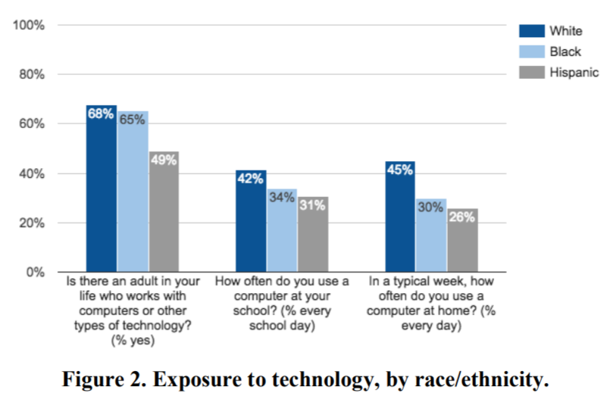
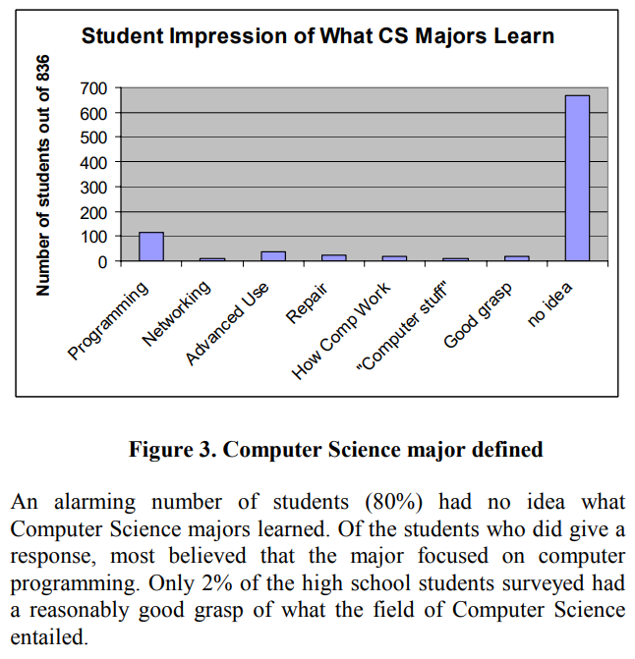
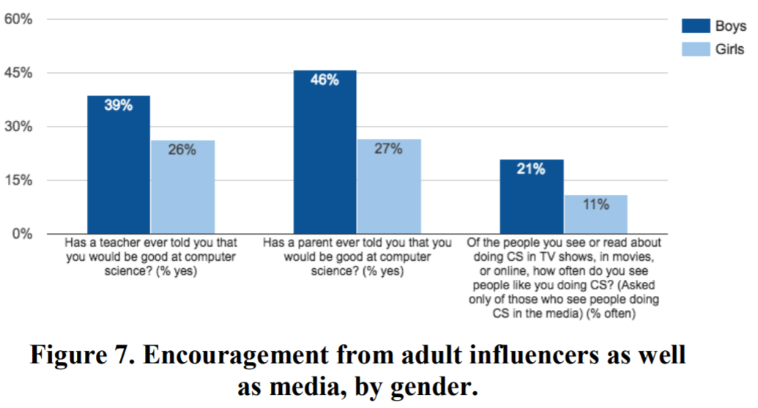
Uphill Battle…
(especially for DEI)
Jennifer Wang and Sepehr Hejazi Moghadam. 2017. Diversity Barriers in K-12 Computer Science Education: Structural and Social. In Proceedings of the 2017 ACM SIGCSE Technical Symposium on Computer Science Education (SIGCSE ’17). Association for Computing Machinery, New York, NY, USA, 615–620. DOI:https://doi.org/10.1145/3017680.3017734
Lori Carter. 2006. Why students with an apparent aptitude for
computer science don't choose to major in computer science.
SIGCSE '06. https://doi.org/10.1145/1121341.1121352

Slide 44






Identity
Key idea that has stuck with me: cura personalis
“care of the whole person”
How do we enculturate a computer science identity in students?
  Stories told around the campfire
  Case studies
How do we help students find their identity?

Slide 45
Real-World Applicability
We have a uniquely modern field, and primary source artifacts are littered all over the internet.
Twitter IPO Disclosures
  System architecture
Facebook Engineering Blog
  React design philosophy & web architecture
Mozilla Foundation
  Repository structure & release planning
Linux Kernel Mailing List
  Mechanism design
Interviews, memoirs, angry blog posts…

Slide 46
Tool Applicability
Use the industrial-grade tools wherever possible
Teach students to be avid consumers of the computer system
Insist on correct usage

Slide 47
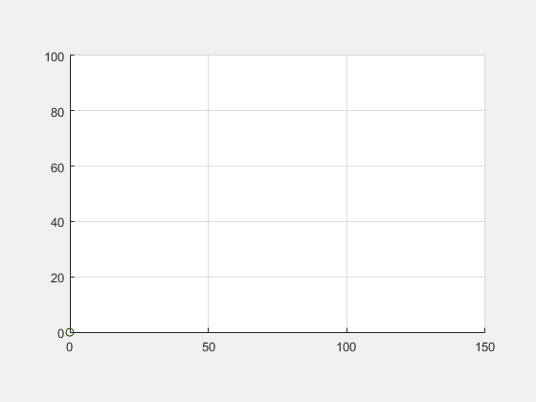
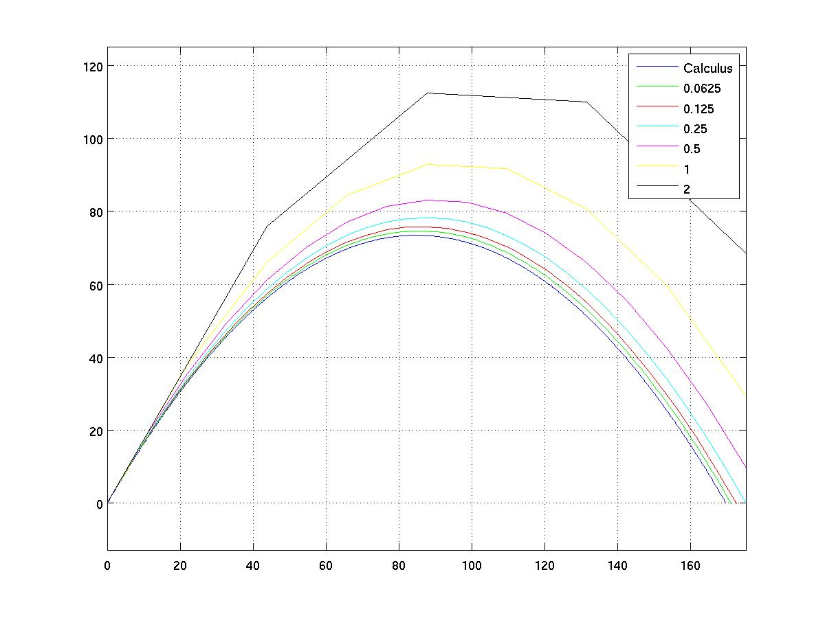
Engagement
Make concepts “real” for the student
  In their context!
  Different for engineers vs. CS students
Choice of context matters

Slide 48
Skills and Confidence
Computer Science is an eminently practical discipline
Most important skill is to put theory into practice
  Code interviews
  Finding a research advisor
  First six months trajectory at first job
Building working artifacts builds skill and confidence, which leads to success
  Confidence to self-evaluate and estimate ability
Most of my courses have implementation as 30-50% of the final grade

Slide 49
Courses Taught
Operating Systems
Principles of Computing Systems
  Concurrency, threading, networking, security
Computer Architecture
Scientific Programming
  Freshman programming for engineers
Capstone
Programming Languages
Compilers
Principles of Software Development
  Development methodologies
The Most Human Computer
  Freshman seminar with programming and AI ethics

Slide 50
Department Service
CS Undergrad Coordinator
1818 Dual Credit Liaison for CS
  Supervise high school dual-credit instructors
  Deliver yearly professional development
CS Undergrad Curriculum Chair
CS Assessment Chair
CS NTT Search Chair

Slide 51
My Vision
Deliver high-quality instruction
“Cross-pollinate” into a new department
Develop excellent curriculum
Participate in department service
Help manage academic programs
Foster mentorship relationships

Slide 52
Thank you!

